Slide 1

Employee Management System
Presentation by:
Shaik Farheen - Batch No: 533
B. Dharakeshwari - Batch No: 536

Slide 2
Agenda
About us
Introduction
Business problem
Problem Statement
Objective
Key Analysis Queries
Data Description
Conclusion
Challenges
Recomendations

Slide 3
About us
Name: shaik Farheen
Education: BSC- Computer Science
I want to learn Data Science because I’m curious about how raw data can tell stories, reveal hidden patterns, and predict what might happen next.
LinkedIn: https://www.linkedin.com/in/shaik-farheen1807
Github: https://github.com/shaikfarheen118
Name: B.Dharakeshwari
Education: Btech- CSE
I want to learn Data Science because it combines curiosity, logic, and creativity. I like the idea of turning a simple question into a data-driven solution that can actually make a difference.
LinkedIn: www.linkedin.com/in/dharakeshwaribanoth
Github: https://github.com/Dharakeshwari-Banoth

Slide 4
Business Problem
The company lacks a centralized system to effectively manage employee details, salaries, leaves, bonuses, jobs, and qualifications. This makes it difficult to track employee performance, control payroll costs, identify staffing needs, and make data-driven HR decisions.

Slide 5
Problem Statement
The company needs an efficient way to manage and analyze employee information, salaries, leaves, bonuses, jobs, and qualifications. The lack of centralized data makes it difficult for HR to track payroll, monitor employee attendance, and make informed workforce decisions. The SQL-based system aims to analyze employee data and provide useful insights for better HR and payroll management.

Slide 6
Objective
The objective of this project is to design and implement an Employee Management System that efficiently stores and manages employee-related data within an organization. The system needs to track various aspects of employee information, including personal details, job roles, salary structures,
qualifications, leave records, and payroll data. The system should ensure the integrity and consistency of data by using relational tables with appropriate foreign keys and cascading actions.
The system should allow for easy management and querying of employee data, providing insights such as payroll calculation, leave tracking, and department-specific job roles.
The goal is to streamline HR operations, ensuring that all relevant employee data is accessible and accurately updated across different modules.

Slide 7
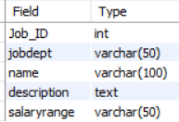
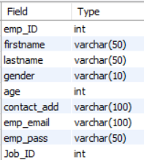
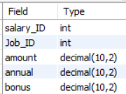
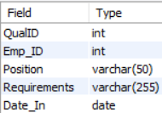
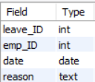
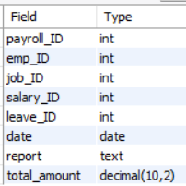
Data Description
Table 1:Job Department
Table 2: Salary Bonus
Table 3:Employee
Table 4:Qualification
Table 5: Leaves
Table 6: Payroll

Slide 8
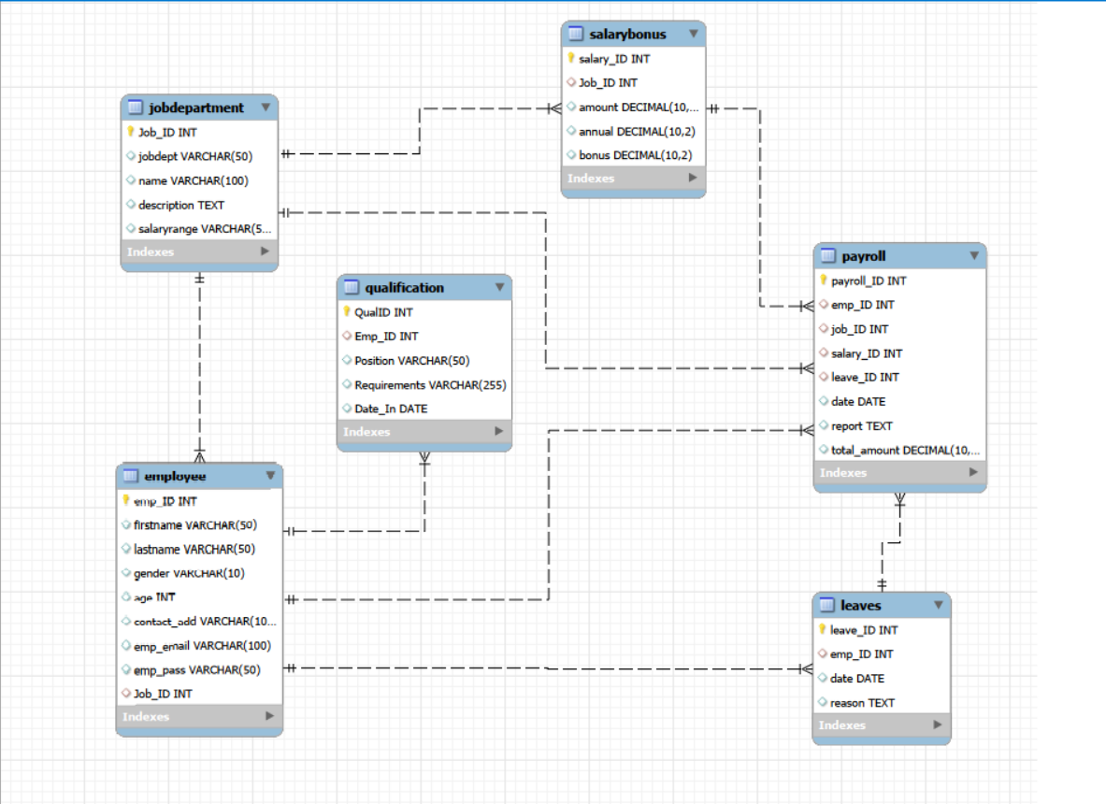
ER Diagram

Slide 9
Cardinalities
Relationship | Cardinality
JobDepartment → Employee | 1 : Many (1:M)
JobDepartment → SalaryBonus | 1 : Many (1:M)
JobDepartment → Qualification | 1 : Many (1:M)
Employee → Qualification | 1 : Many (1:M)
Employee → Payroll | 1 : Many (1:M)
Employee → Leaves | 1 : Many (1:M)
SalaryBonus → Payroll | 1 : Many (1:M)
Payroll → Leaves | 1 : 1

Slide 10
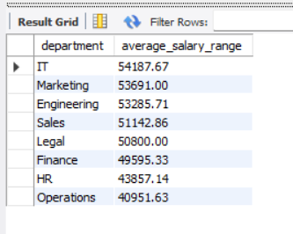
Key Analysis Queries
1. What is the average salary range per department?
SELECT
jobdept AS department,
ROUND(
AVG(
(
CAST(REPLACE(SUBSTRING_INDEX(salaryrange, '-', -1), '$', '') AS DECIMAL(10,2))
-
CAST(REPLACE(SUBSTRING_INDEX(salaryrange, '-', 1), '$', '') AS DECIMAL(10,2))
)
), 2
) AS average_salary_range
FROM JobDepartment
GROUP BY jobdept
ORDER BY average_salary_range DESC;
Insights: The query calculates the average salary range (maximum salary − minimum salary) for each department and ranks departments from highest to lowest.

Slide 11
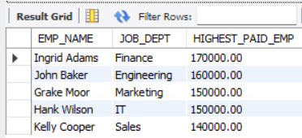
Key Analysis Queries
2. Who are the top 5 highest-paid employees?
SELECT CONCAT(E.FIRSTNAME, ' ', E.LASTNAME) AS EMP_NAME, JD.JOBDEPT AS JOB_DEPT, S.AMOUNT AS HIGHEST_PAID_EMP
FROM EMPLOYEE E
JOIN JOBDEPARTMENT AS JD
ON E.JOB_ID = JD.JOB_ID
JOIN SALARYBONUS AS S
ON JD.JOB_ID = S.JOB_ID
ORDER BY HIGHEST_PAID_EMP DESC
LIMIT 5;
Insights: The query identifies the top 5 highest-paid employees by salary amount. It displays their name, job department, and salary, with results sorted from highest to lowest salary.

Slide 12
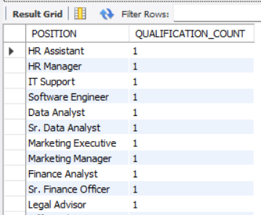
Key Analysis Queries
3.Which positions require the most qualifications?
SELECT POSITION,
COUNT(QUALID) AS QUALIFICATION_COUNT
FROM QUALIFICATION
GROUP BY POSITION
ORDER BY QUALIFICATION_COUNT DESC;
Insights: The query identifies which positions require the most qualifications by counting the qualifications for each position. The results are sorted in descending order, so the position with the highest qualification count appears first.

Slide 13
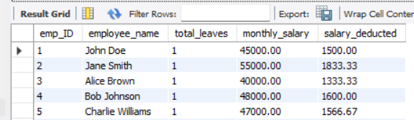
Key Analysis Queries
4.How do leave days correlate with payroll amounts?
SELECT
e.emp_ID,
CONCAT(e.firstname, ' ', e.lastname) AS employee_name,
COALESCE(l.total_leaves, 0) AS total_leaves,
sb.amount AS monthly_salary,
ROUND(
(sb.amount / 30) * COALESCE(l.total_leaves, 0),
2
) AS salary_deducted
FROM Employee e
LEFT JOIN (
SELECT
emp_ID,
COUNT(leave_ID) AS total_leaves
FROM Leaves
GROUP BY emp_ID
) l
ON e.emp_ID = l.emp_ID
LEFT JOIN SalaryBonus sb
ON e.Job_ID = sb.Job_ID
ORDER BY total_leaves DESC;
Insights: The insight is that payroll deduction depends on both leave days and monthly salary. Employees with the same leave days can have different deductions because their salaries differ, while more leave days result in a higher deduction.

Slide 14

Key Analysis Queries
5.Which department receives the highest total bonuses?
SELECT JD.JOBDEPT AS DEPARTMENT,
SUM(S.BONUS) AS TOTAL_BONUS
FROM JOBDEPARTMENT AS JD
JOIN SALARYBONUS AS S
ON JD.JOB_ID = S.JOB_ID
GROUP BY JD.JOBDEPT
ORDER BY TOTAL_BONUS DESC
LIMIT 1;
Insights: The query identifies the department receiving the highest total bonuses by summing bonus amounts for each department. The department with the largest total bonus appears first, showing where the company spends the most on employee bonuses.

Slide 15
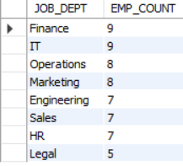
Key Analysis Queries
6.Which departments have the highest number of employees?
SELECT JD.JOBDEPT AS JOB_DEPT, COUNT(E.EMP_ID) AS EMP_COUNT
FROM EMPLOYEE AS E
JOIN JOBDEPARTMENT AS JD
ON E.JOB_ID = JD.JOB_ID
GROUP BY JOB_DEPT
ORDER BY EMP_COUNT DESC;
Insights: "The analysis shows that the IT department has the highest number of employees, followed by Sales. This indicates that IT and Sales are the organization's major workforce areas and may require greater resource and workforce planning."

Slide 16

Key Analysis Queries
7.Which year had the most employees taking leaves?
SELECT YEAR(DATE) AS LEAVE_YEAR,
COUNT(DISTINCT EMP_ID) AS EMPLOYEES_ON_LEAVE
FROM LEAVES
GROUP BY YEAR(DATE)
ORDER BY EMPLOYEES_ON_LEAVE DESC
LIMIT 1;
Insights: "The analysis identifies the year with the highest number of employees taking leave. This helps HR understand employee absence patterns and plan workforce requirements more effectively."

Slide 17
Conclusion
The Employee Management System provides a structured way to manage and analyze important employee information. Using SQL, the project helps identify salary patterns, bonus distribution, leave impact on payroll, and qualification requirements across positions. These insights can help HR teams control payroll costs, plan workforce requirements, and make informed employee-related decisions. Overall, the project demonstrates how SQL can transform employee data into meaningful business insights for better HR management.

Slide 18
Challenges
● Defining correct table relationships and ensuring accurate use of foreign keys.
● Maintaining data consistency with cascading updates and deletes.
● Writing complex joins for reports involving employee roles, leaves, and payroll.
● Ensuring all date fields follow the YYYY-MM-DD format for reliable time-based analysis.
● Preventing duplicate entries using unique constraints, especially on email fields.

Slide 19
Recommendations / Future Enhancements
Add Performance Tracking
Store employee performance ratings, appraisals, promotions, and training records to analyze employee growth.
Create Interactive Dashboards
Connect the SQL database with Power BI or Tableau to create dashboards showing employee count, salary trends, department distribution, attrition, and performance.
Implement Role-Based Access
Provide different access levels for HR, managers, and employees so that sensitive employee information is protected.
Add Employee Attrition Analysis
Analyze factors such as salary, department, experience, and performance to identify employees who may be likely to leave the organization.
Add Automated Notifications
Implement notifications for upcoming leave, birthdays, work anniversaries, performance reviews, and contract expiry dates.

Slide 20


Slide 21

THANK YOU

